Slide 1



myTaxiService
Project Plan Document
(PPD)
Computer Science and Engineering (CSE)
Software Engineering 2 Project
Year 2015/16
Background Music:
Hungarian Rhapsody no.2 - F. Liszt
SE2 – Andrea Martino, Francesco Marchesani
POLITECNICO DI MILANO

Slide 2

About PPD
SE2 – Andrea Martino, Francesco Marchesani
The main scope of this PPD (Project Plan Document) is to give an overall guidance to the project-planning phase of the project, which is myTaxiDriver (Software Engineering 2 project of year 2015/16 - Politecnico di Milano).
We will focus in particular on the algorithmic methods used in practice (Function points and COCOMO II), on the tasks identification, on the project scheduling, on the resources allocation and on the risk analysis.
POLITECNICO DI MILANO

Slide 3
About the project deliveries
SE2 – Andrea Martino, Francesco Marchesani
RASD
Deadline: 06/11/2015
Final Presentation
TBA
ITPD
Deadline: 21/01/2016
Design Document
Deadline: 04/12/2015
PPD
Deadline: 02/02//2016
Inspection Document
Deadline: 05/01/2016
POLITECNICO DI MILANO

Slide 4
Function Points Macro-categories
SE2 – Andrea Martino, Francesco Marchesani
Internal Logical File (ILF): homogeneous set of data used and managed by the application.
External Interface File (EIF): homogeneous set of data used by the application but generated and maintained by other external applications.
External Input: elementary operation to elaborate data coming from the external environment (from users).
External Output: elementary operation that generates data for the external environment. It usually includes the elaboration and a proper representation of data from logic files.
External Inquiries: elementary operation that involves input and output (e.g. specific requests of the user in order to visualize his/her information). This category does not implies significant elaboration of data from logic files.
POLITECNICO DI MILANO

Slide 5
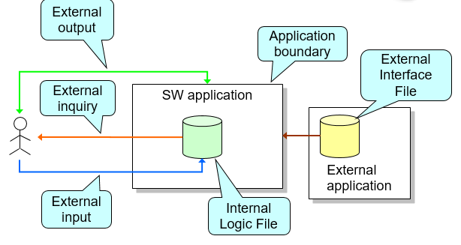
FPs in a nutshell
SE2 – Andrea Martino, Francesco Marchesani
POLITECNICO DI MILANO

Slide 6
FPs Weights Table
SE2 – Andrea Martino, Francesco Marchesani
Function types N. Inputs N. Outputs N. Inquiry N. ILF N. EIF | Weight
 | Simple 3 4 3 7 5 | Medium 4 5 4 10 7 | Complex 6 7 6 15 10
POLITECNICO DI MILANO

Slide 7
Total UFPs computation
SE2 – Andrea Martino, Francesco Marchesani
mTS Function Types | Total weight
N. External Inputs | 24
N. External Outputs | 24
N. External Inquiries | 16
N. ILF | 42
N. EIF | 0
TOTAL NUMBER OF UFPs | 106
POLITECNICO DI MILANO

Slide 8
UFPs histogram
SE2 – Andrea Martino, Francesco Marchesani
POLITECNICO DI MILANO

Slide 9
UFPs Pie Chart
SE2 – Andrea Martino, Francesco Marchesani
POLITECNICO DI MILANO

Slide 10
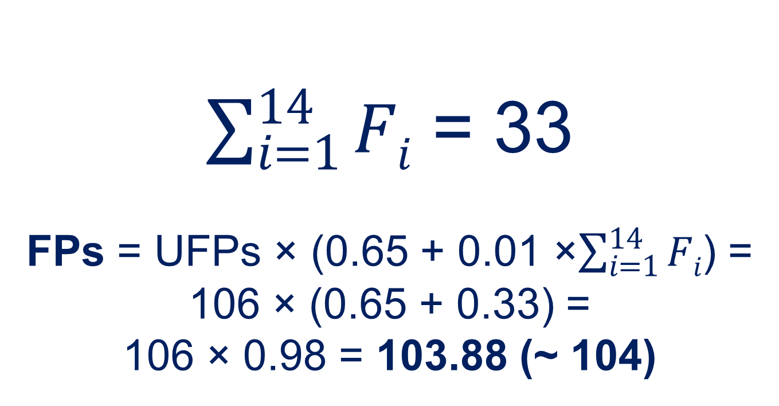
FPs computation
SE2 – Andrea Martino, Francesco Marchesani
GSC | F_{i} coefficient | GSC | F_{i} coefficient
1. Data Communication | 4 | 8. Online Update | 2
2. Distributed Data Processing | 1 | 9. Complex Processing | 3
3. Performance | 5 | 10. Reusability | 1
4. Heavily Used Configuration | 2 | 11. Installation Ease | 2
5. Transaction Role | 3 | 12. Operational Ease | 3
6. Online Data Entry | 2 | 13. Multiple Sites | 0
7. End-User Efficiency | 3 | 14. Facilitate Change | 2
$\sum_{i=1}^{14}{Fi}$ = 33
FPs = UFPs × (0.65 + 0.01 ×$\sum_{i=1}^{14}{Fi}$) =
106 × (0.65 + 0.33) =
106 × 0.98 = 103.88 (~ 104)
POLITECNICO DI MILANO

Slide 11
COCOMO II
SE2 – Andrea Martino, Francesco Marchesani
The Constructive Cost Model (COCOMO) is an algorithmic software cost estimation model developed by Barry W. Boehm. The model uses a basic regression formula with parameters obtained from historical project data and current as well as future project characteristics.
We will focus on COCOMO II, which is the improved version of the original model.
By the way, we will use this approach to estimate effort and cost of mTS project.
From a practical point of view, we will use the COCOMO II – Constructive Cost Method generator (http://csse.usc.edu/tools/COCOMOII.php) that takes into account all the scale drivers of this technique.
POLITECNICO DI MILANO

Slide 12
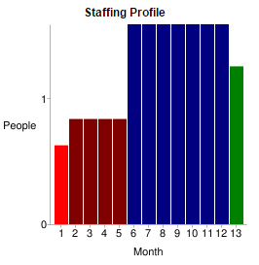
COCOMO II results
SE2 – Andrea Martino, Francesco Marchesani
Total Equivalent Size = 5618 SLOC
Effort = 15.3 Person-months
Schedule = 11.7 Months
Cost = $30624
POLITECNICO DI MILANO

Slide 13
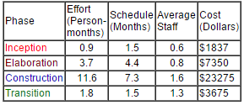
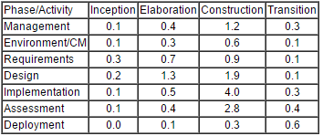
COCOMO II results
SE2 – Andrea Martino, Francesco Marchesani
POLITECNICO DI MILANO

Slide 14
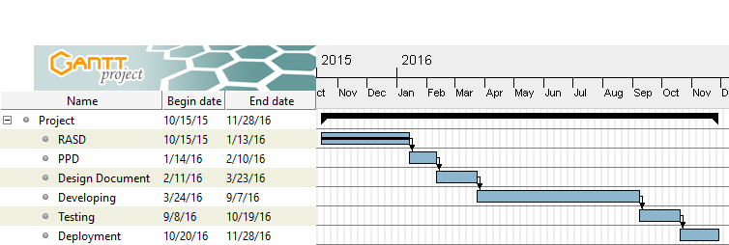
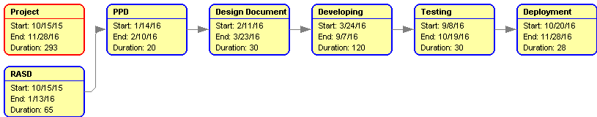
Project schedule
SE2 – Andrea Martino, Francesco Marchesani
POLITECNICO DI MILANO

Slide 15
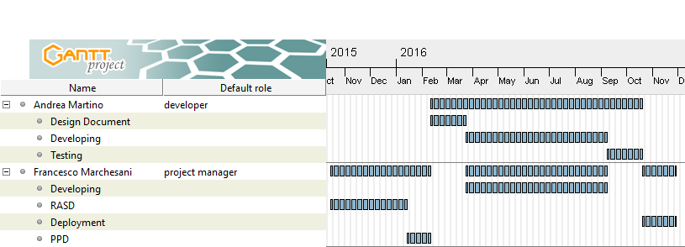
Resources allocation
SE2 – Andrea Martino, Francesco Marchesani
POLITECNICO DI MILANO

Slide 16
Risk Analysis
SE2 – Andrea Martino, Francesco Marchesani
Risk | Relevance | Recovery actions
Organizational finance problems | 3/5 | Prepare a briefing document for senior management of the project in order to show how the project is making a very important contribution to the goals of the business and presenting reasons why cuts to the project budget would not be cost-effective, (they can only contribute to decrease the income).
Recruitment problems | 2/5 | Tell the customers about probability of delays and search for pre-developed components that can fit myTaxiService project (without developing similar components from scratch).
Staff illness | 4/5 | Considering that the probability of illness in winter is high, in case of illness we can perform team re-organization and meetings about work done by ill colleagues (in order to understand each other’s job).
POLITECNICO DI MILANO

Slide 17
Risk analysis
SE2 – Andrea Martino, Francesco Marchesani
Defective components | 2/5 | Substitute potentially defective components with bought-in components of known reliability, in order to avoid problems.
Requirements changes | 3/5 | Derive traceability information to assess requirements change impact (it can be catastrophic in certain cases). We also need to perform information hiding in the project design in order to avoid chains of changes in the architecture.
Organizational restructuring | 1/5 | As said for Organizational finance problems, we can prepare a document for a senior management to show that the project is very important for the business of the company and it is important to fulfill respecting the deadlines.
Database performances | 2/5 | Consider the possibility of a general improvement of the database, with better performances.
Underestimated development time | 4/5 | Consider the “make or buy” tradeoff, searching for suitable components of the project developed externally.
POLITECNICO DI MILANO

Slide 18

Thank you!!!
SE2 – Andrea Martino, Francesco Marchesani
POLITECNICO DI MILANO

